Slide 1
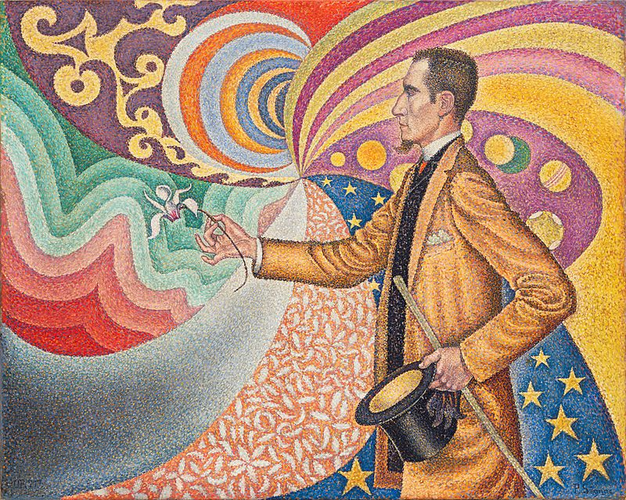
Sensation and Perception
Monzia Mushtaq
BRAC University
PSY 101

Slide 2
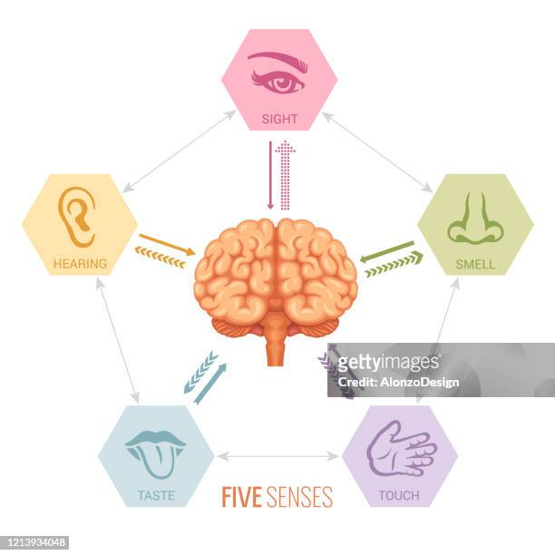
Our all senses are working together as a team, in order to navigate successfully in the world

Slide 3
Sensation and Perception
Sensations can be defined as the process by which our sensory receptors and nervous system receive and represent stimulus energies from our environment.
Perception can be defined as the process of selecting, organizing, and interpreting the sensory information, enabling us to recognize meaningful objects and events.

Slide 4
How do Sensation and Perception work together?
1) Sensation occurs
sensory organs absorb energy from a physical stimulus in the environment.
sensory receptors convert this energy into neural impulses and send them to the brain.
2) Perception follows
the brain organizes the information and translates it into something meaningful.

Slide 5
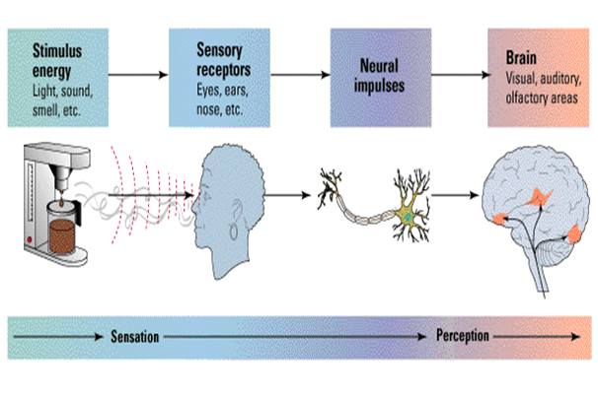
The process of sensation and perception (visual) Diagram
Source of diagram: https://empowercommunityhealth.org/sensation-and-perception/

Slide 6
Thresholds
Threshold: A dividing line between what has detectable energy and what does not.
Absolute Threshold: The minimum stimulation needed to detect a particular stimulus 50 percent of the time.

Slide 7
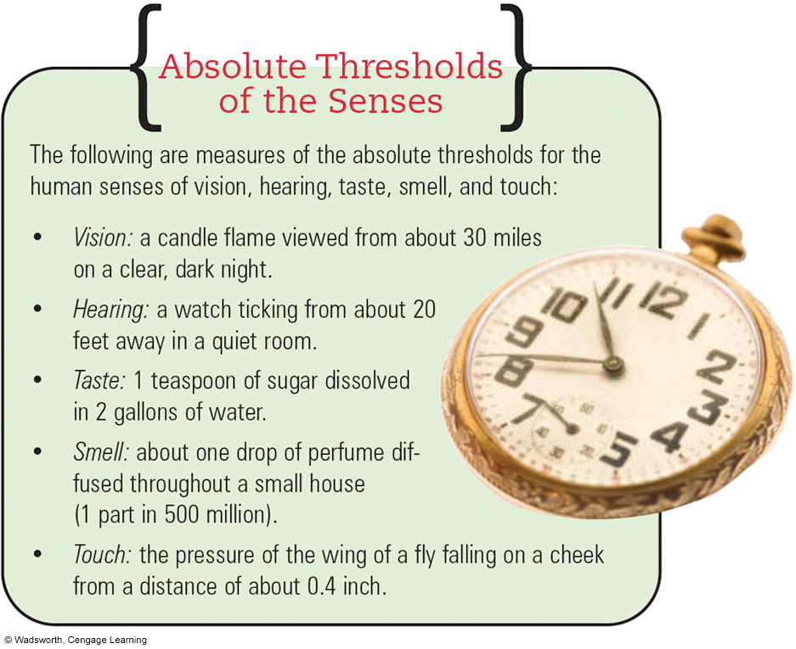

Slide 8
Difference Threshold
The minimum amount of stimulus intensity change needed to produce a noticeable change.
the greater the intensity (ex., weight) of a stimulus, the greater the change needed to produce a noticeable change.
For example, when you pick up a 5 lb weight, and then a 10 pound weight, you can feel a big difference between the two. However, when you pick up 100 lbs, and then 105 lbs, it is much more difficult to feel the difference.

Slide 9
Signal Detection Theory-Psychology
It’s application specially in decision making and other areas

Slide 10
Signal Detection Theory
A psychological theory regarding a threshold of sensory detection.
It relates to the idea that the intensity of the stimuli and the psychological and physical state of the person contribute to whether or not the person is able to detect the stimuli.
The basic idea behind signal detection theory is that neurons are constantly sending information to the brain , even when no stimuli are present. This is called neural noise. The level of neural noise fluctuates constantly. When a faint stimulus, or signal, occurs, it creates a neural response. The brain must decide whether the neural activity reflects noise alone, or whether there was also a signal.

Slide 11
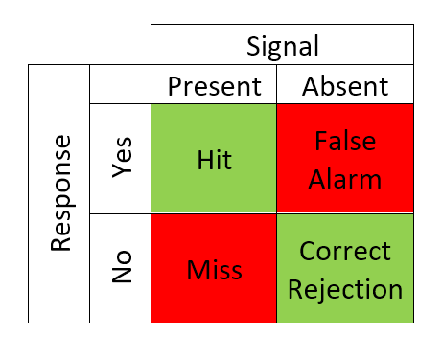

Slide 12
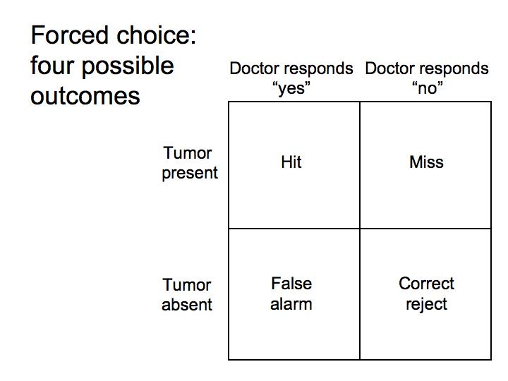

Slide 13
Sensory Adaptation
Fool Your Senses

Slide 14
Sensory Adaptation
Diminished sensitivity as a consequence of constant stimulation
The heat of the oil while frying, for a chef
The sound of the rolling machine in a construction sight, for a worker

Slide 15
Vision
vision is an interpretation of the world around us
visual illusions demonstrate the gap between what is out there and how our minds and brains interpret what is out there
illusions are rare because our minds and brains have evolved to have interpretations that almost always work brilliantly in our environment without us having to think about it

Slide 16
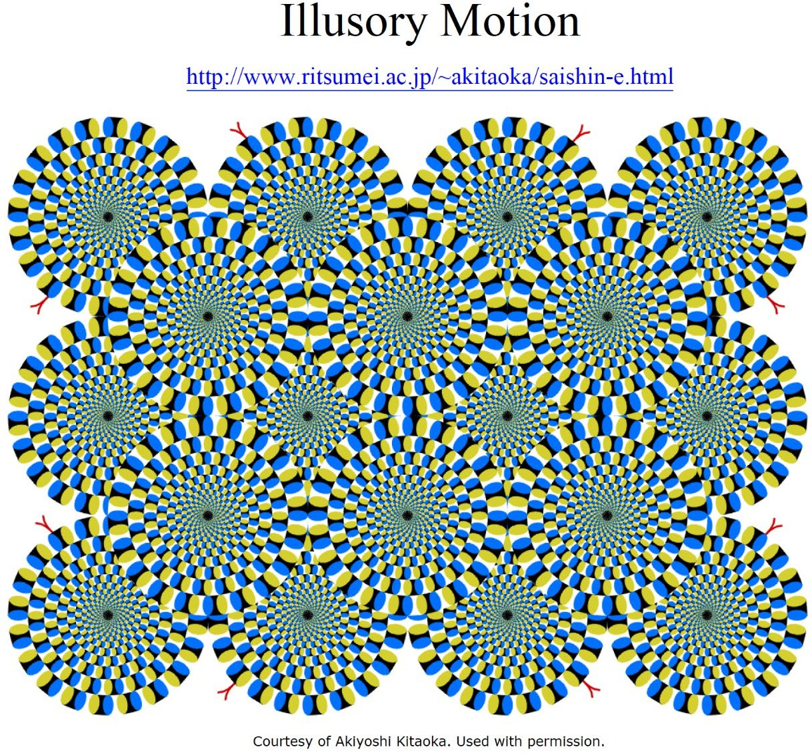

Slide 17
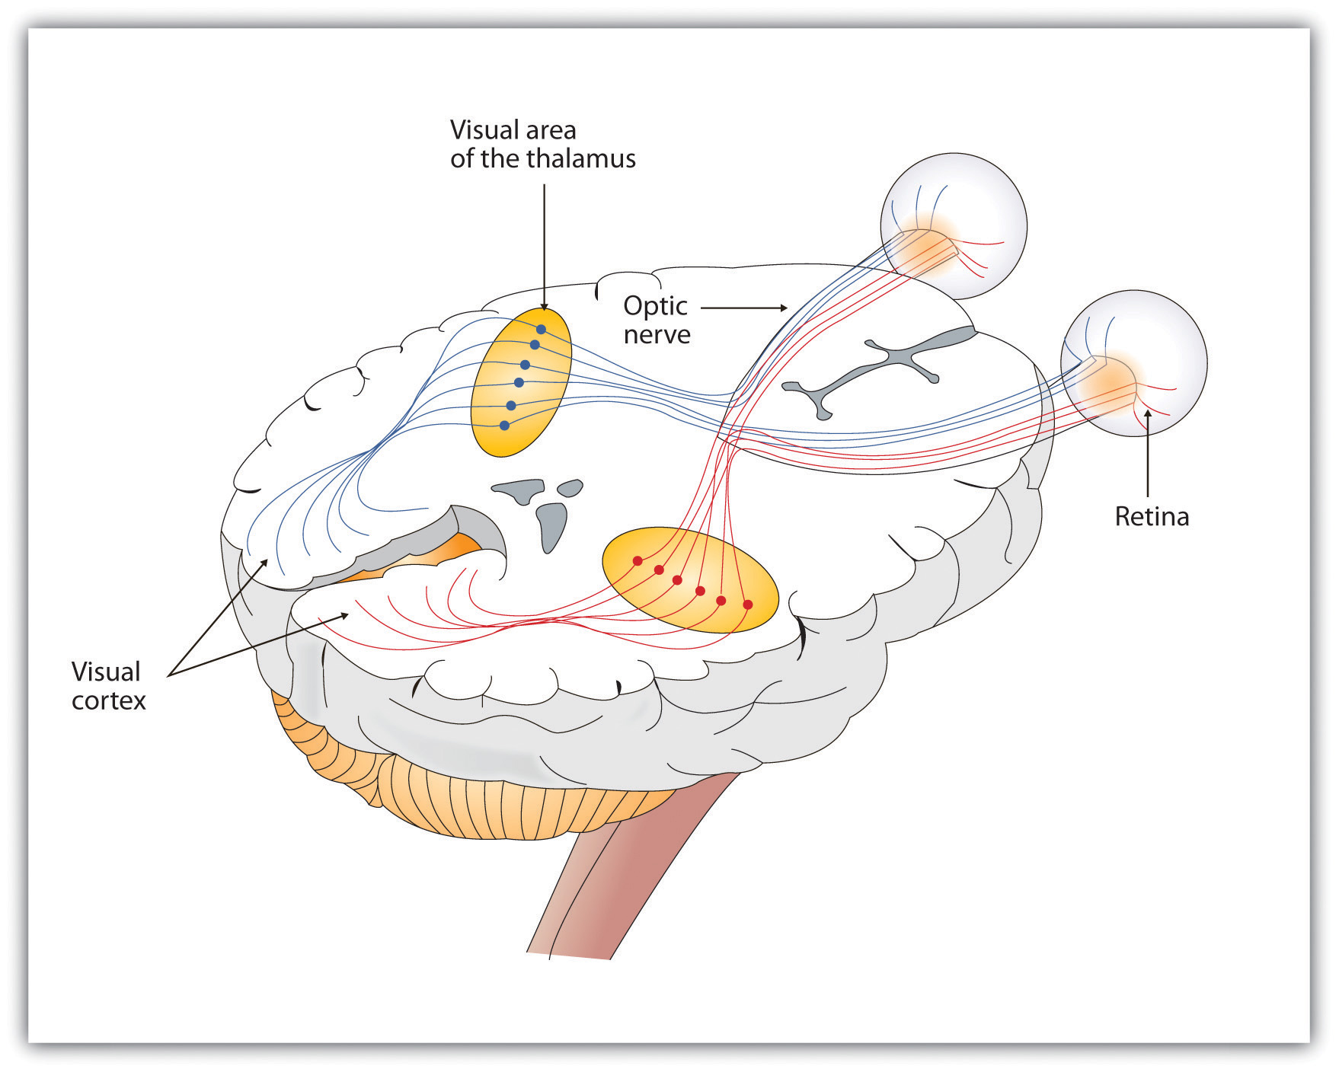
Vision
Seeing
Retina
Cortex

Slide 18
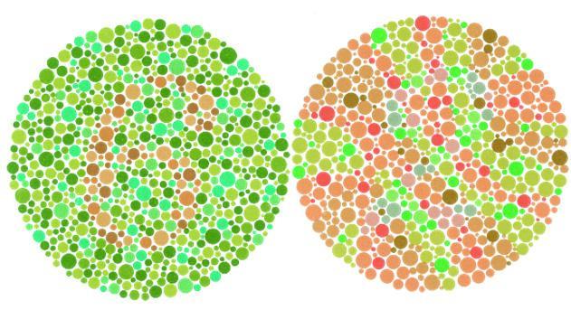
Colour Vision
Young - Helmholtz trichromatic (three - color) theory says that the retina contains three different color receptors—
one most sensitive to red, one to green, one to blue—which, when stimulated in combination, can produce the perception of any color
Notes:
RETINA: the light - sensitive inner surface of the eye, containing the receptor rods and cones plus layers of neurons that begin the processing of visual information.
RODS: retinal receptors that detect black, white, and gray; necessary for peripheral and twilight vision, when cones don’t respond
CONES: retinal receptor cells that are concentrated near the center of the retina and that function in daylight or in well - lit conditions. The cones detect fine detail and give rise to color sensations.

Slide 19
Color Blindness
Color blindness or color vision deficiency (CVD) is the decreased ability to see color or differences in color.

Slide 20
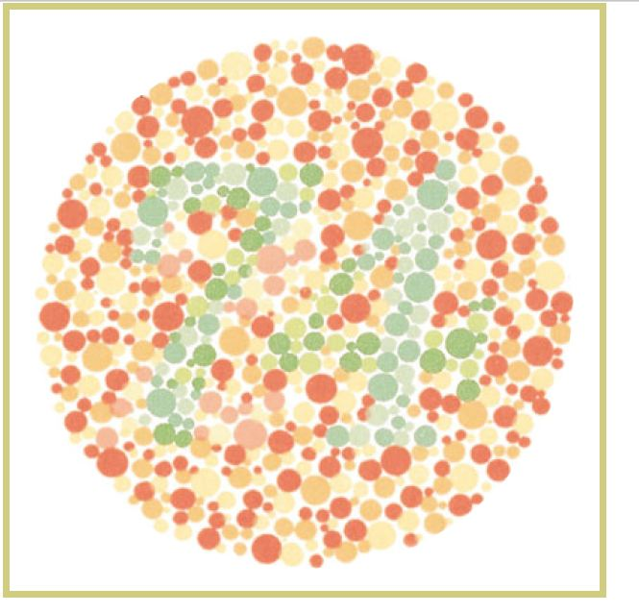
Viewers with normal color vision should clearly see the number "74".

Slide 21
Visual Information Processing

Slide 22
Feature Detection
David Hubel and Torsten Wiesel (1979) have demonstrated that neurons in the occipital lobe receive information from the ganglion cells in the retina . These feature detector cells have the ability to respond to a scene’s specific features—to particular edges, lines, angles, and movements.
Psychologist David Perrett and his colleagues (1988, 1992, 1994) reported that have a “vast visual encyclopedia” distributed as cells that specialize in responding to one type of stimulus—such as a specific gaze, head angle, posture, or body movement. Other supercell clusters integrate this information and fire only when the cues collectively indicate the direction of someone’s attention and approach. This instant analysis, which aided our ancestors’ survival.

Slide 23
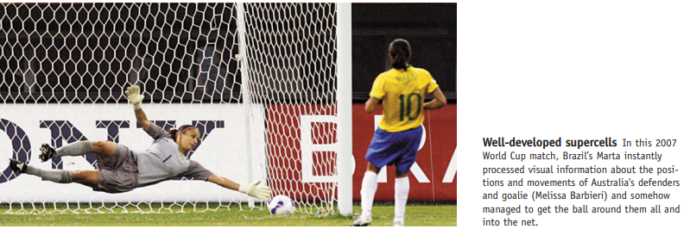

Slide 24
Parallel Processing
the processing of many aspects of a problem simultaneously; the brain’s natural mode of information processing for many functions, including vision. Contrasts with the step - by - step (serial) processing of most computers and of conscious problem solving.

Slide 25
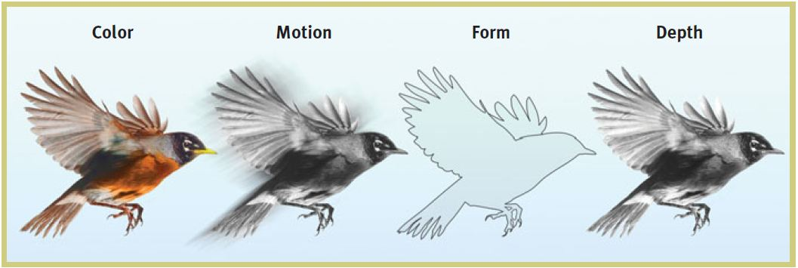

Slide 26
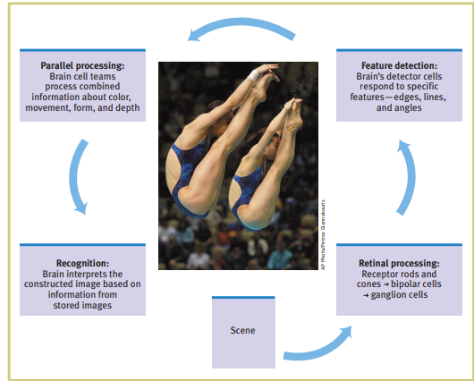
Simplified Summary of Visual Information Processing

Slide 27


